Slide 1

ihwrlhlqikjdfhi
Prepared by: Dr. Nidhi Joshi

Slide 2
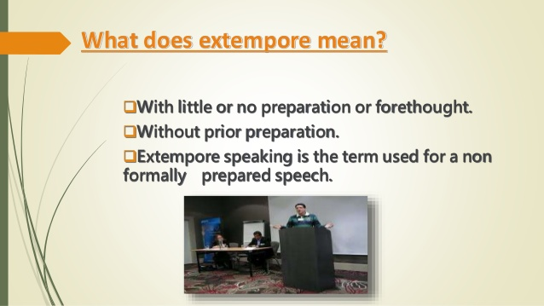

Slide 3


Slide 4


Slide 5
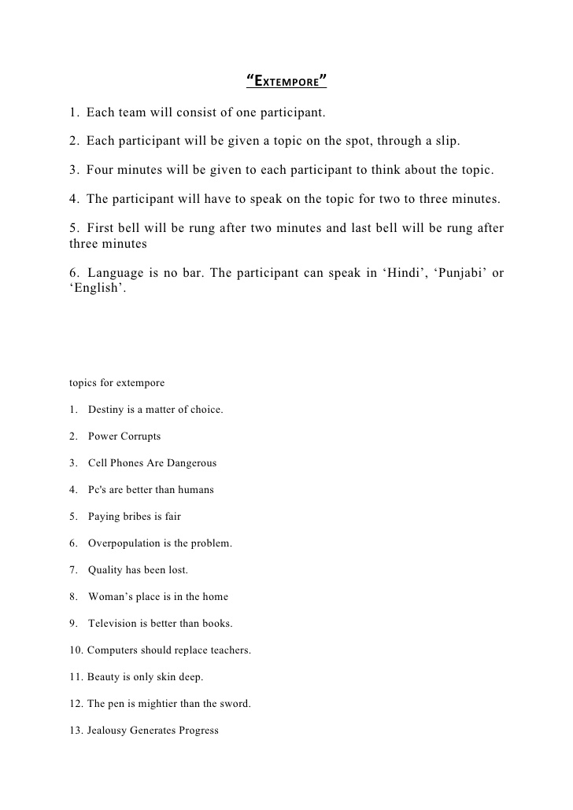
Extempore topics

Slide 6
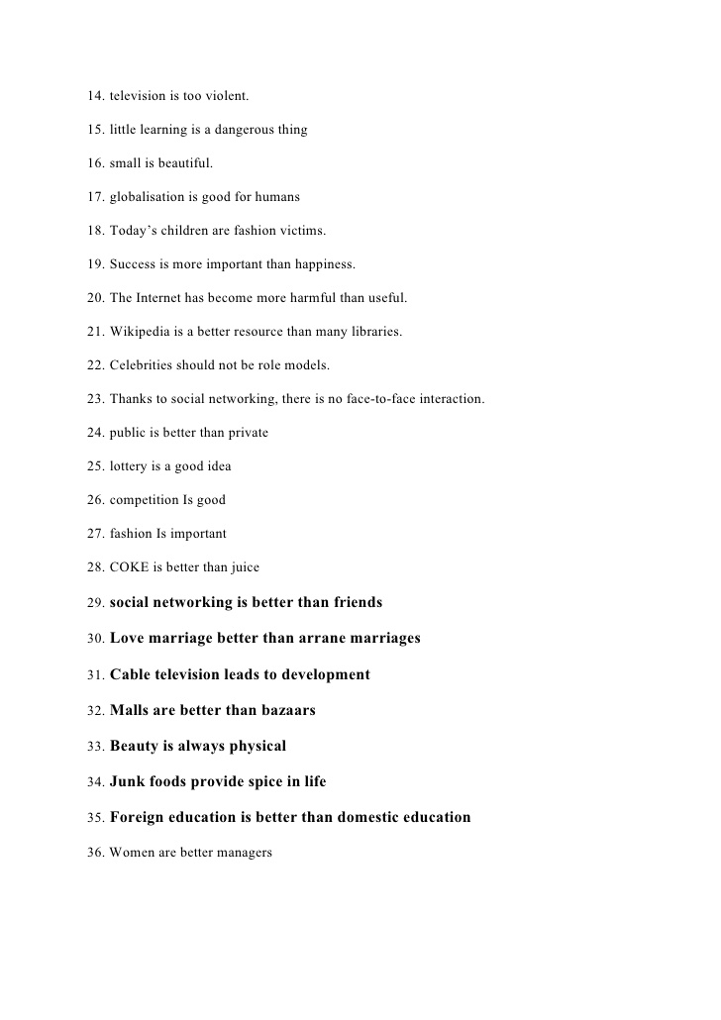

Slide 7
37. My favorite day of the year.
38. If I could only eat three foods forever.
39. If I could design a school.
40. Why books are important.
41. Three surprising facts about me.
42. How to impress your parents.
43. How to plan a party.
44. A job I'd love to have.
45.A day in my life.
46. If I could have dinner with anyone.
47. If I could travel through time.
48. My favorite book.
49. An important lesson I've learned.
50.What I've learned from cartoons.
51. The smartest cartoon character.

Slide 8
My three favorite animals.
What you would find in my closet. Make something up.
What you'd find under my bed.
The best letter of the alphabet.
Why your mom/dad is special.
A day that stands out.
The best surprise ever.
I lost it!
If I had a million dollars to give away.
If cats/dogs ruled the world.
A trip to remember.

